Slide 1

If it’s not about elephants, it’s irrelephant: Memes for thought
Getting the Learning Happening
Kylie Malinowska
Young Learner Advisor, IHWO
Notes:
Hello. My name is Kylie Malinowska. I’m a Prague based Teacher and Trainer, and the Young Learner Advisor for IHWO. I’m also a coffee addict and mum of 4 year old trilingual twins. I like reading, elephants, and curly fries.

Slide 2

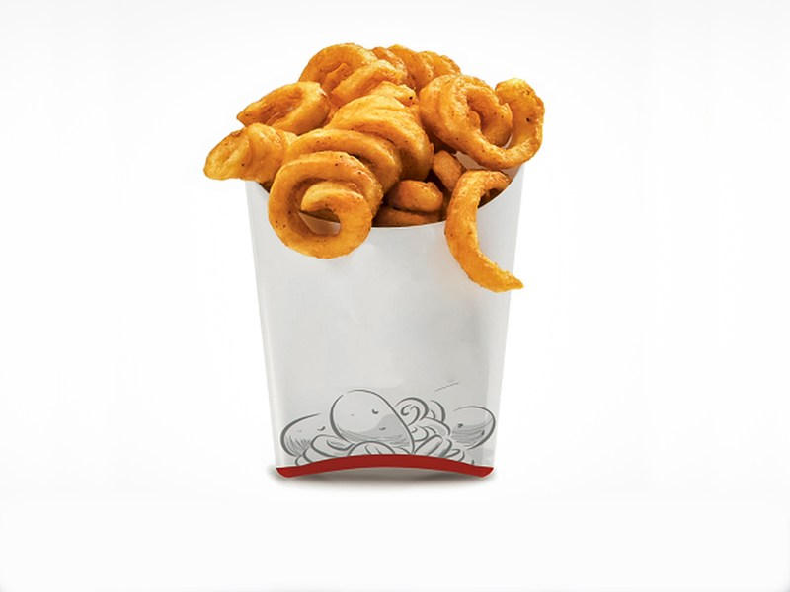
Notes:
The curly fry conundrum

Slide 3

“Teaching YL is easy.
A bit of colouring, maybe a story, and a few games here and there to make the lessons fun and interesting. Simple.”
Said no YL teacher, ever.
Notes:
How many times have you heard this?
There’s and unfortunate myth, that teaching YLs is straightforward, or simple even and that they only need simple language and simple lessons with a few games thrown in to keep it interesting.
It’s true, we DO play games. But…..
A good YL teacher needs language awareness and teaching skills.
A good YL teacher needs to be highly skilled to reach into children’s minds and understand how they make sense of the world.
As for children only needing simple lessons and language, I truly believe that children can do so much more than we give them credit for or even allow them to and by not exploiting that potential we are doing them a disservice.
About 11 years ago when I started at IH Prague I was given some really great advice which changed the way I thought about teaching YL. It was in reference to a group of particularly challenging 13yr olds.
The advice was “don't be afraid to …..TEACH them”. She didn't mean don‘t be afraid to step in the room. Which would also have been good advice for this particular class. She was referring to that bit of our job where we expect them to learn something. I remember having a moment……and realising that I was so caught up in choosing activities and classroom management that I'd almost forgotten about the learning bit.
As YL teachers, we have so much to think about. Is it any wonder then that often the elephant in the room is the learning?
For me, something that rivals my morning coffee, is the pure joy of watching a child’s face light up when they know they are learning something new. So today I’m going to share some practical activities and tips, and an invitation to join me, if you havent already, in taking a learning centred perspective in your YL classrooms.

Slide 4


What does your classroom look like?
Notes:
Does anyone recognise this picture? It’s the window from playschool.
The first window is a window into an adult classroom. Close your eyes. What can you see. What does the classroom look like? What are the students doing? What is the teacher doing? What activities or tasks are they doing? How are the students feeling? How is the teacher feeling? What can you hear?
The second window is a window into a YL classroom. Not just any YL classroom, but the classroom of an experienced and wonderful YL teacher who loves their job and works in a school that really values their YL programme and has the classroom set up accordingly. Close your eyes. What can you see. What does the classroom look like? What at the students doing? What is the teacher doing? What activities or tasks are they doing? How are the students feeling? How is the teacher feeling? What can you hear?
The last window is also a window into a YL classroom. This YL classroom though could be anywhere in any school. The teacher is a substitute teacher who by choice doesn’t usually teach YL. We called them in at the last minute because the regular teacher is sick. Close your eyes. What can you see. What does the classroom look like? What at the students doing? What is the teacher doing? What activities or tasks are they doing? How are the students feeling? How is the teacher feeling? What can you hear? What can you smell?
Which of these windows does your classroom look like?

Slide 5
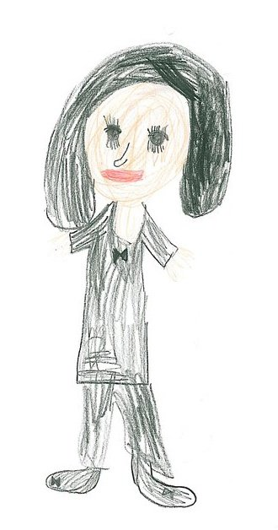
Activity 1: Guided Imagery
Guided Imagery is great for YL!!
Maybe you’ve already heard of schema and semantic network theory and that YL need to connect new language to their own world etc., but….
did you know that some cognitive theorists have done studies showing that mental imagery is not just great for comprehension and memory, but it can also lead to greater grammatical awareness and understanding and that the cognitive act of mental imagery is connected to the verbal processes!
Notes:
Activity 1. Guided Imagery.
More often than not, when we do some kind of listening, especially from a coursebook, we set the learners tasks which have right or wrong answers. But does this equal learning? What is it that we really want? What I really want for my young learners is for them to want to listen to English. To enjoy listening to English. To actively engage in English.
One of the things I love about reading novels is the imagery that is all mine. Imagining what my favourite character looks like, sounds like, smells like.
Try listening to a story and instead of asking comprehension questions, get the learners to imagine the scene, the characters clothing, the weather. Give them questions that don’t have an answer and are only limited to their imagination.

Slide 6
Activity 1: Guided Imagery
Get them learning…
Foster their powerful imaginations
to encourage exploration &
effectuate deeper thought

Slide 7
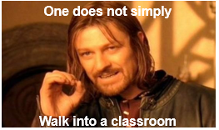
Teaching adults is NOT the same as teaching children
Notes:
Many moons ago, long before I did my DELTA and MA in TESOL, I did a CELTA. At IH Newcastle, like.
I thoroughly enjoyed it. I learnt lots of cool stuff, like the third conditional, how to talk less, that everything should be discussed in pairs, and that you can’t just press play on the cassette player. Yep. It was that long ago. I even met the man who would father my beautiful children. I loved the CELTA. My only problem with the CELTA……
Teaching adults is NOT the same as teaching children
Sure, many skills are transferable, and it is possible to ‘teach’ the same way, but to be a successful and confident YL teacher, one really should understand the unique needs and differences and the implications for both teaching and learning.

Slide 8
Write down 10 words
Don’t think about it too much
A verb
A noun
An adverb
An comparative adjective
A gradable adjective
A number you like
A number you don’t like
A noun
An adverb
A noun
Notes:
Grab a piece of paper.
Don‘t think too much. Write the first thing that comes to your mind.

Slide 9
Activity 2:
Get them learning…
Understand developmental needs &
use age appropriate tasks and materials
Notes:
Some differences between YL and Adults are immediately obvious. They are smaller. They are livelier. And often more enthusiastic. But underneath the generalizations, there are important differences which are a result of a YLs linguistic, psychological, physical, cognitive and social development. These differences have significant implications in the classroom and shape the way we think about the language we teach and the activities we use.
For example, from what age would you give learners the activity I just gave you? Why?

Slide 10
Younger Learners:
are still 1________ing cognitively, so we need to consider the cognitive demands of a 2___________.
appear to learn things 3_________, but are also quick to forget.
have less life experience and thus tend to have a 4____________ world.
need familiar contexts to understand 5 ___________ concepts and need support to understand the abstract.
generally don’t develop metacognitive awareness until after 6_________ at least and until after 7____________ don’t have the knowledge or metalanguage to talk about language.
need help to notice 8_________s.
need new language to be introduced and learnt 9___________ and understood aurally.
tend to measure their progress by the number of 10_________s they know.
Notes:
Fill in your words from the previous task.
Share with your partner.
Is it funny?
Do they fit?
What do you think the real words are?

Slide 11
Activity 2: Mad Lib
There’s nothing mad about using MAD Libs !
Mad Libs can be used for developing metacognitive awareness, helping learners notice language and features of a written text, revising vocabulary or structures, contextualising language, extension, revision… etc and best of all, it’s silly!
Notes:
Other ways to use Mad Libs include….
Book blurbs
Newspaper stories
Letters
Any gap fill activity
If there is fun to be had a child will find it. They love the ridiculous and when you’re 8, there is not much funnier than inserting the word poo into a sentence for no reason at all. If you learners laugh during a mad lib, its great, not because that means they are having a great time in your lesson, but because it means they are noticing that words don’t fit.

Slide 12
Get them learning…
Let them choose,
encourage fun &
help them to notice language

Slide 13
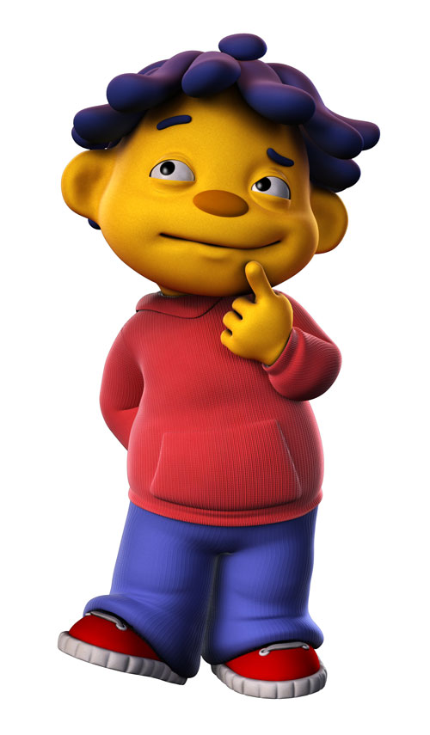
Notes:
Two things are important when doing mad libs, firstly to let them share their crazy texts. But then to give the opportunity to go back and change, or at least think about, what the words should be.
So, with a partner, what SHOULD the words in the text be?

Slide 14
Younger Learners:
are still 1________ing cognitively, so we need to consider the cognitive demands of a 2___________.
appear to learn things 3_________, but are also quick to forget.
have less life experience and thus tend to have a 4____________ world.
need familiar contexts to understand 5 ___________ concepts and need support to understand the abstract.
generally don’t develop metacognitive awareness until after 6_________ at least and until after 7____________ don’t have the knowledge or metalanguage to talk about language.
need help to notice 8_________s.
need new language to be introduced and learnt 9___________ and understood aurally.
tend to measure their progress by the number of 10_________s they know.
Notes:
Fill in your words from the previous task.
Share with your partner.
Is it funny?
Do they fit?
What do you think the real words are?

Slide 15
Younger Learners:
are still developing cognitively, so we need to consider the cognitive demands of a task…
…and ensure they don’t outweigh the learning outcomes.
And, for older YL, we need to ensure the content is challenging enough even if the English is simple.
Notes:
Let’s check your answers…..

Slide 16
Younger Learners:
appear to learn things quickly, but are also quick to forget.
They also lose interest more quickly and are less able to keep themselves motivated on tasks they find difficult or uninteresting.

Slide 17
Younger Learners:
have less life experience and thus tend to have a smaller world…
….which increases with age.

Slide 18
Younger Learners:
Need familiar contexts to understand new concepts and, depending on the age, need varying levels of support to understand the abstract.
Meaning needs to be accessible.

Slide 19
Younger Learners:
generally don’t develop metacognitive awareness until after 7 at least and until after 11 don’t have the knowledge or meta-language to talk about language.

Slide 20
Younger Learners:
need help to notice things.

Slide 21
Younger Learners:
need new language to be introduced and learnt orally and understood aurally.

Slide 22
YL Foreign Language Learning
Learning the written language
Learning the Oral skills
Vocabulary
Discourse
Conversation
Extended Talk
Grammar
Notes:
In CELTA, language tends to be divided into the 4 skills: Listening, Speaking, Reading and Writing and then we have our systems: Grammar, Vocabulary, Phonology.
But is this division appropriate for YL? Given the holistic way in which they learn, and that literacy skills are a whole new skill set that adult learners have already acquired, maybe this more organic model from Lynne Cameron is more appropriate?

Slide 23
Younger Learners:
tend to measure their progress by the number of words they know.

Slide 24
Notes:
Speaking of words…
Let’s take a brain break and do a quick word association game. I’ll say a word, and you think of the first word that comes to mind.
DOG.
TABLE.
BANANA.

Slide 25
Younger YL tend to make syntagmatic associations
DOG - Bark TABLE - eat BANANA - monkey
They make thematic links and tend to learn words well in collections.
Older YL tend to give paradigmatic responses - words from the same word class.
DOG - Cat TABLE - chair BANANA - apple
Notes:
Younger YL tend to make syntagmatic associations e.g. DOG - Bark TABLE - eat BANANA monkey they make thematic links and tend to learn words well in collections.
Whereas older Young Learners tend to give paradigmatic responses. CAT. CHAIR. APPLE.
This shift probably reflects other developments e.g. when they are more able to deal with abstract connections as they move from concrete to abstract. As a child’s world grows, so will their ability to make both syntagmatic and paradigmatic associations.

Slide 26
Younger Learners:
are still developing cognitively, so we need to consider the cognitive demands of a task.
appear to learn things quickly, but are also quick to forget.
have less life experience and thus tend to have a smaller world.
need familiar contexts to understand new concepts and need support to understand the abstract.
generally don’t develop metacognitive awareness until after 7 at least and until after 11 don’t have the knowledge or metalanguage to talk about language.
need help to notice things.
need new language to be introduced and learnt orally and understood aurally.
tend to measure their progress by the number of words they know.

Slide 27
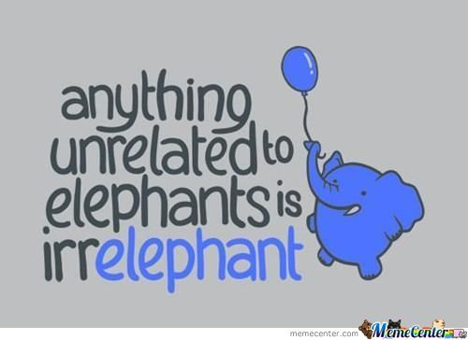
Activity 3: The enormous elephant
Notes:
This is one of my favourite activities that I’ve collected over the years.
Do the elephant story.
Why did I show you the elephant story? Why do I like it so much?

Slide 28
Activity 3: The enormous elephant
TPR ticks all the right boxes!
fun and engaging
Considers aptitude & development of the learners
Primacy of process and conditions over language
helps learners connect to the language
Physically engaging
Forges new connections to help with remembering and internalising
Gets kids moving about
Memorable
Never fails to impress
Notes:
There are all sorts of good reasons for doing the elephant story with young learners……..Why else though might I include it in this session?
How many of are here in this room because you are hoping to take some fun new activities back to your YL classrooms?
Teachers are great scavengers. We love to collect new ideas for activities and build up a bank of ‘fun’ things to do in the classroom. And everyone loves a collector. Learners, parents of happy learners, fellow teachers stuck for new ideas…
I shared the elephant story with you because I like it. Kids like it. My trainees like it. In fact, I like this activity so much that I created a whole session around it. And why not? It works! People love the elephant story. It’s fun. It’s memorable.
But how often are we guilty of getting caught up in the superficial (the game or task itself, the materials, the technology) and forget about the actual learning?
How often do we mention curly fries because it’s an interesting story then attempt to make a tenuous link to the rest of our message?
Konya anecdote

Slide 29
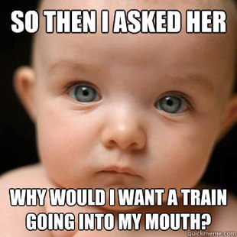
Activity 3: The enormous elephant
Notes:
It’s fine to have favourite activities. More than fine. But we need to remember to ask ourselves a few important questions:
Why am I using it? Honestly?
Is it relevant? Useful?
What do we hope the learners get out of it?

Slide 30
Get them learning…
Having an understanding
of and reminding ourselves of the underlying principles and key pedagogy helps ensure we don’t cling to our
materials and activities and making lessons fun.

Slide 31
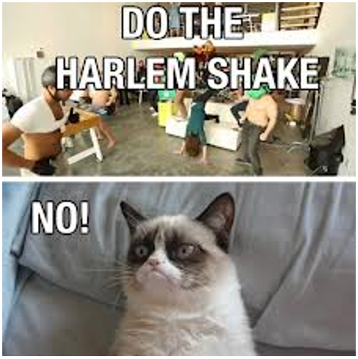
Notes:
I’m sure you all have something that you’ve been told is a good idea, but for whatever reason, you don’t do it in your classroom. Do you skip songs because you hate singing? Do you skip pronunciation work because you’ve prioritised other things? Or maybe you never do role plays after one too many eye rolls from learners?
As human beings we hear what we want to hear and interpret input so that it fits their framework. We do things in a way that works well not just for our students, but also for us, and for our style of teaching. We need to feel comfortable.
It’s good to have our own style and beliefs about teaching, but by remaining static we run the risk of liking something about an activity, so we focus on something good and miss the point, or just getting stuck in our ways.
What song am I humming? (hokey pokey). To me it’s the hokey pokey and always will be. I just can‘t bring myself to sing it any other way. Can you finish this line for me….. Wheels on the bus. Mine go all day long…. Not all through the town.
Put up your hand if your guilty of getting stuck in your ways?
Elicit how to do a drawing dictation?

Slide 32
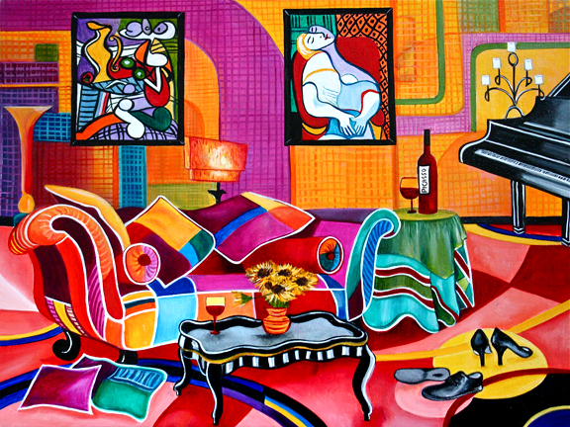
Notes:
Grab a piece of paper and a pen.
Grad something to write on. E.g. a book.
Put the book and the paper on your head.
I’m going to describe my bedroom. Listen. And Draw it.
As you walk in the bedroom there is a window with large curtains on the back wall.
To the left of the window, there is a small wardrobe.
On the right hand side of the room there is a desk against the wall and a small office chair. There is a computer on top of the desk.
On the left hand side there is a big queen sized bed.
On top of the bed there are two fluffy pillows.
Next to the pillows is Brad Pitt. Naked. :D

Slide 33
Activity 4: Picasso Dictation
Turn picture dictation on it’s head!
All too often, our students know an activity well, but they don’t necessarily share our task goals. ‘Listen and draw’ receptive activities are great, particular for non-readers and writers, but as the younger age group are still developing their fine motor and creative skills, they will naturally focus their attention on making sure the picture is aesthetically pleasing. Drawing this way helps focus on what is really important.

Slide 34
Get them learning…
Mix things up!
Make tweaks to help children focus on language and learning.
Let them in on the task goals.

Slide 35
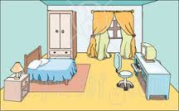
Notes:
Often we tend to over-rely on materials.
So…What else could we do with this picture?

Slide 36
Label the picture – Vocabulary items
Label the picture – Phrases
Label the picture – Differences
Chant/ drill the vocabulary items
Draw own Bedroom
“In this picture” YLE prep. Compare picture to; original, partners, own bedroom
Draw and Guess where: Preposition
Battle ships
Information exchange
Writing: about bedroom
Writing: about ‘artist’
Art exhibit.
Speaking: Talking about the picture/ bedroom/ artist
Notes:
Here is just a few things I came up with quickly. The possibilities are almost endless.

Slide 37
Get them learning…
Let go of the safety net.
Teach the learner, not the material.

Slide 38

Notes:
When doing your lesson planning, what question do you ask yourself?

Slide 39
How do I teach this?
Notes:
Commonly, a teacher will ask ‘How do I teach this?’ Which is a very good question.

Slide 40
Does teaching = learning?
Is what we teach what is learned?
Notes:
But…..Does teaching equal learning? Is what we teach the same as what is learned?

Slide 41
Does teaching = learning?
Is what we teach what is learned?
INPUT
≠
INTAKE
Notes:
Input, what we teach, is NOT the same as intake. We can try and help learners to process input and assimilate language to their interlanguage system, but they will not process all the input available to them. Some of what they hear or read may not be understood. Some will receive more attention for various reasons. It is the learner who decides what is important or salient to them.
So perhaps a better question to ask is……

Slide 42
How do I teach this?
How does a learner learn this?
Notes:
How does a learner learn this? Which should then be interpreted as How can I ensure learners learn this? (How can I minimise the input/intake gap?)

Slide 43
How do I teach this?
How does a learner learn this?
How can I ensure learners learn this?
Notes:
Rather than taking the starting point How do I teach this? Teachers should ask themselves How does a learner learn this? Which should then be interpreted as How can I ensure learners learn this? (How can I minimise the input/intake gap?)

Slide 44
How do I teach this?
How does a learner learn this?
How can I ensure learners learn this?
How can I minimise the input/intake gap?
*Taken from the IH CYLT course, session 17: Aims and Objectives
Notes:
Rather than taking the starting point How do I teach this? Teachers should ask themselves How does a learner learn this? Which should then be interpreted as How can I ensure learners learn this? (How can I minimise the input/intake gap?)
*mention Krashen and SSR

Slide 45
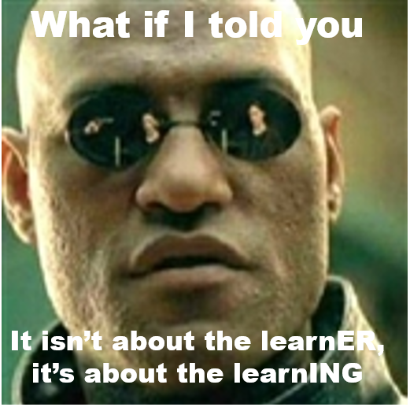

Slide 46
Is there an
“over-attention to mechanics of task and material and to the pursuit of “fun” and an under-attention to the moment-by-moment learning that our practices might or might not lead to”
in the YL classroom?
Notes:
Does Anyone recognise this quote?

Slide 47
Is there an
“over-attention to mechanics of task and material and to the pursuit of “fun” and an under-attention to the moment-by-moment learning that our practices might or might not lead to”
in the YL classroom?
Taken from Scrivener and Underhill, 2012
Notes:
It’s taken from Jim Scrivener and Adrian Underhill’s Demand High ELT site.
When they did the rounds a few years back in 2012, it really resonated. What I heard was something I had heard and thought about many times before. It made me think of the advice I mentioned earlier, and most notably one of my favourite books. Lynne Cameron’s 2002 ‘Teaching Languages to Young Learners’.
The first line of the book, which I duly underlined is: This is a book about teaching that puts learning in the centre of the frame. Chapter 1, again heavily underlined, is ‘Taking a learning-centred perspective’.
I genuinely believe that YL teachers, faced with the plethora of age specific challenges they need to deal with, are especially susceptible to over-relying on tasks and materials and keeping children ‘happy’.
Ive included memes in this session because Jim and Adrian referred to demand high as a meme.
Let me share with you a metaphor from Cameron’s book….
…... imagine a child standing at the edge of a country and that the country represents new ideas and all that can be learnt: Ahead of the child are paths through valleys and forests, mountains to be climbed, cities to be explored. The child, however, may not be aware of these vast opportunities and, being a child, may be content at the first stream or field or may rush from place to place without exploring. When a teacher is centred on the child, there is a temptation to stay in that place or follow the child.

Slide 48
Guided Imagery
Mad Libs
TPR Story
Picture Dictation
Your own
What do the learners need to know/ be able to do?
Are they sufficiently challenged? Are they capable of more?
How can we stop “covering material” and start focusing on the potential for deep learning?
What small tweaks and adjustments can we make to shift the whole focus of our teaching towards getting that engine of learning going?
Notes:
So how can we focus on the learning?

Slide 49
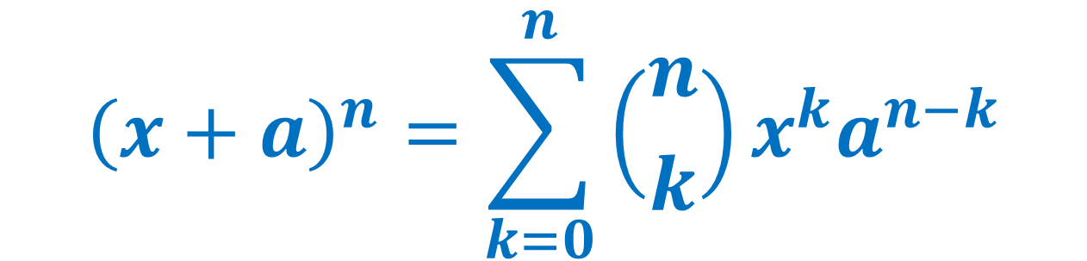
How do we get learning happening?
$${\left(x+a\right)}^{n}=\sum_{k=0}^{n}{\left({n \atop k}\right)x^{k}a^{n−k}}$$
Notes:
A few years ago a colleague returned from IATEFL bursting at the seams with all his new found ideas and knowledge. He proudly shared with us that he’d learnt the secret formula to that all elusive learning thing….
This isn’t it…..

Slide 50
How do we get learning happening?
KA = Kp + A + M + O
Notes:
This is what he shared with us….
KA = Kp + M + O
Knowledge acquired = previous knowledge + ability + motivation + opportunity
We can get learning happening by understanding development and where the learner is coming from
We can get learning by understanding and acknowledging what a child is capable of
We can get learning happening by choosing a range of appropriate and engaging tasks that will motivate our learners
We can get learning happening and make our classroom conducive to learning by providing opportunities.
Opportunities for using language.
Opportunities for practicing language.
Opportunities for engaging with the language.
Opportunities for enjoying the language.
Opportunities for learning.
But I have a much simpler magic formula.

Slide 51

Get them learning…
Get rid of that elephant!!
Notes:
Get rid of the elephant in the room. Don’t be afraid of getting them learning.
And the way to get rid of an elephant in the room is the same way you eat one. One mouthful at a time.

Slide 52

Thank you for listening
Kylie Malinowska
Young Learner Advisor &
YL Training Coordinator
International House World Organisation
email: yladvisor@ihworld.com
blog: klokanomil.wordpress.com
www.ihworld.com
Notes:
If anyone is interested in the YL Training courses offered by IHWO, they can ask me questions, grab a flyer, come visit the IHWO stand, visit our website

Slide 53

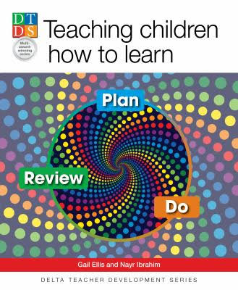
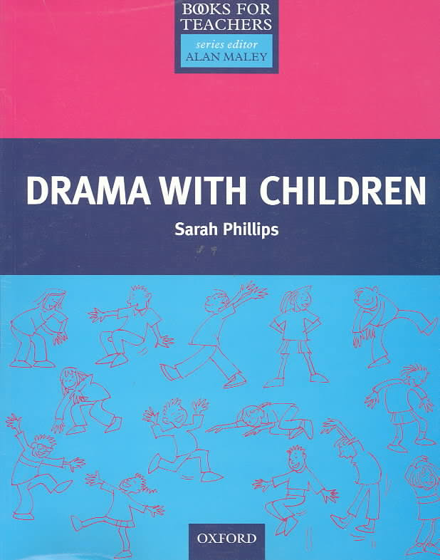
Resources
Notes:
Thank you for listening

